Slide 1
Yelp Data Mining
Emily Dutile, Vyshaal Narayanam, Xiwen Song, Tony Tian

Slide 2




Meet the Team
Xiwen Song
Emily Dutile
Tony Tian
Vyshaal Narayanam

Slide 3
Topics of Focus
What neighborhoods in a city have the best cuisine selection?
Are some areas more upscale or divey?
Can we recommend a particular dish at a top restaurant?
What topics are discovered frequently in reviews? Do they correlate positively or negatively to a review?

Slide 4
Yelp Dataset
The dataset is given in the SQL file
4.7 million reviews
156,000 business
12 metropolitan areas
Focused on the restaurants reviews
Pittsburgh, PA (2089 restaurants, 53 neighborhoods, 43 different cuisines)
Github: https://github.com/emily-jean/yelp-data-mining

Slide 5
Methods
Preprocessing
Tokenization
Filtering
Lemmatization
Stemming
Clustering
Recommendation System
Topic Modeling

Slide 6
Clustering
K-Means
Gaussian Mixture Model
DBSCAN

Slide 7
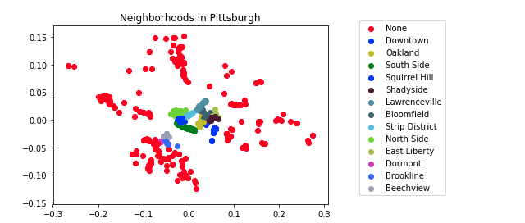
Clustering

Slide 8
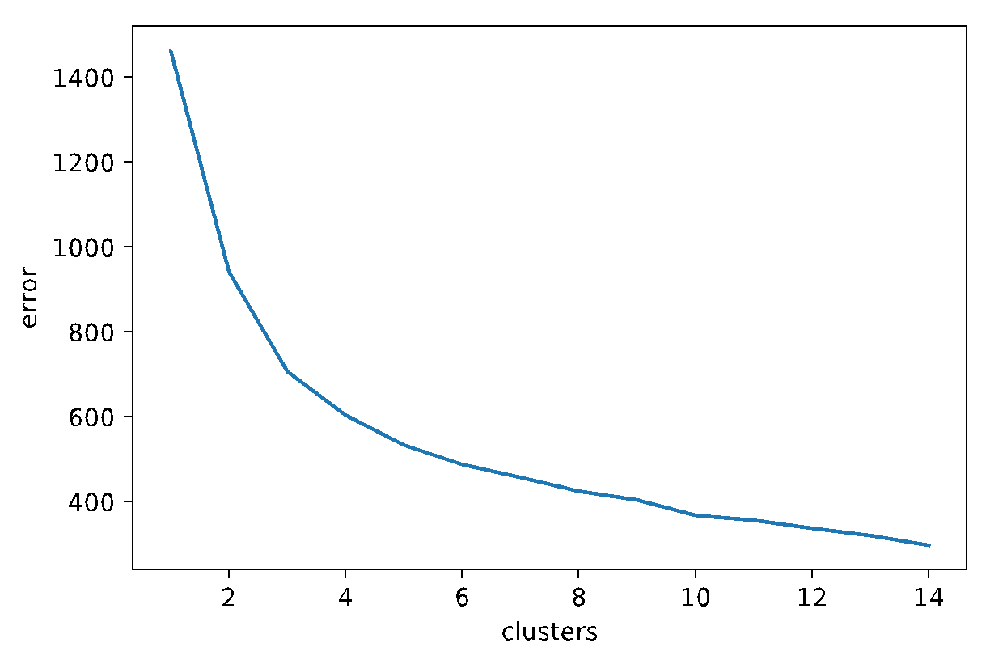
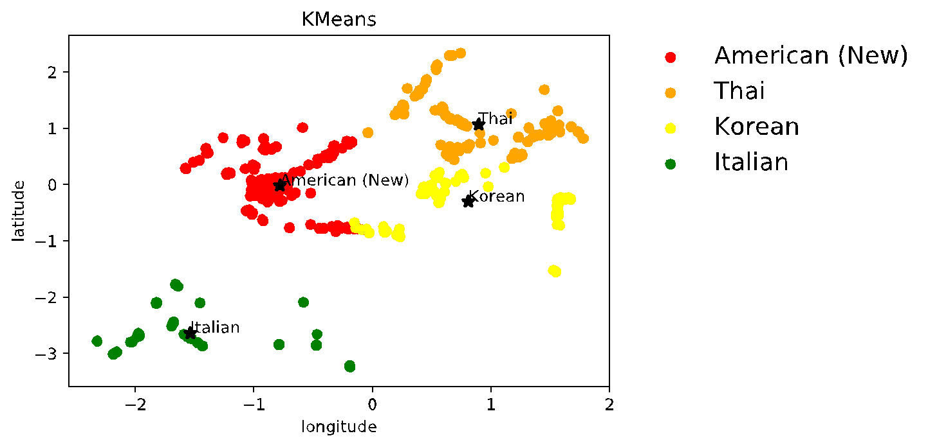
Clustering
K-Means
Longitude+Latitude = closeness
Cuisine = similarity
Exclusive
One-hot: [0,0,1,0,1,0,0]
Silhouette Score
0.29

Slide 9
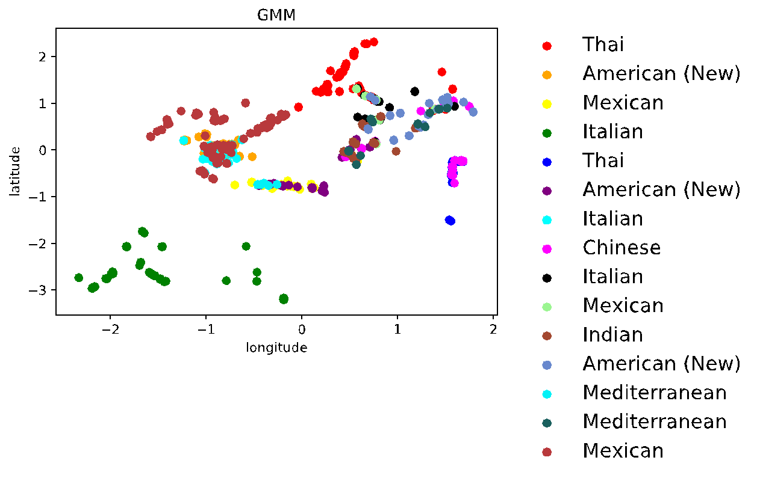
Clustering
Silhouette Score
0.31

Slide 10
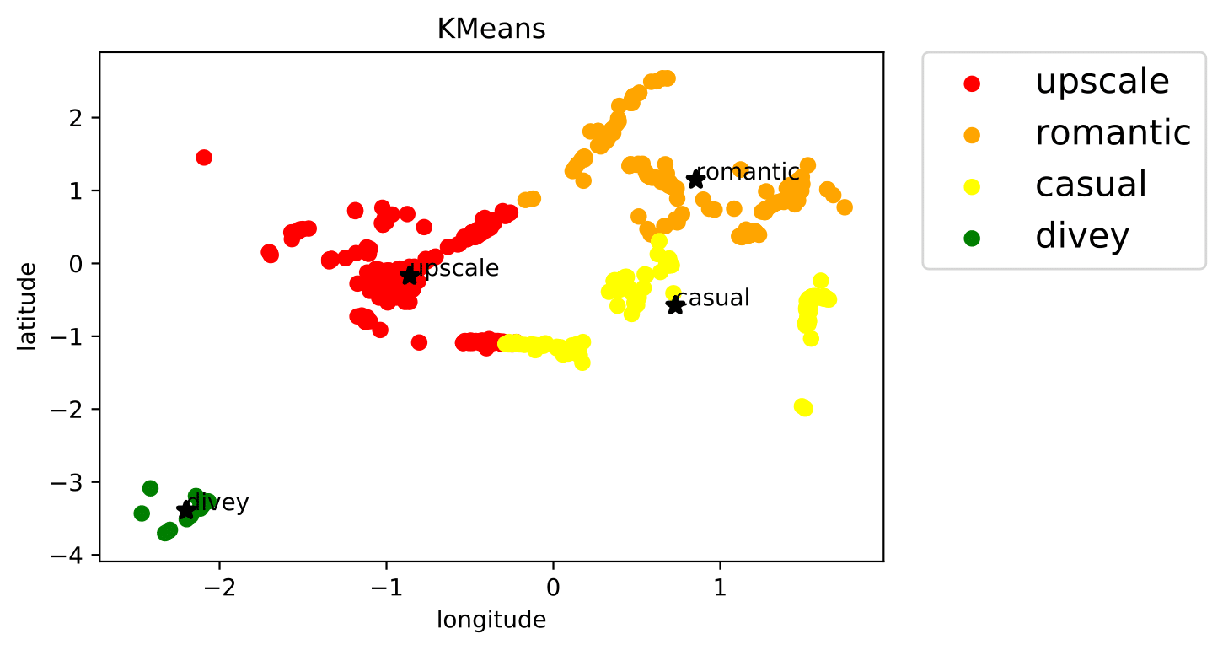
Clustering
Attributes:
upscale
divey
classy
romantic
touristy
trendy
casual
Silhouette Score
0.38

Slide 11
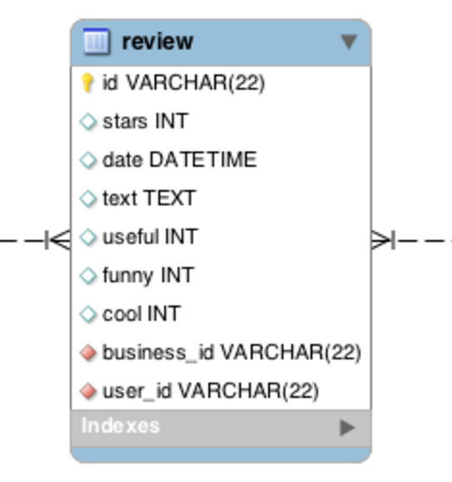
Recommendation System
Utility Matrix
stars
business_id
user_id
Notes:
Besides the clustering analysis, we also but up our recommendation. We made up the utility matrix by extracting business id, user id and rating stars for each review.

Slide 12
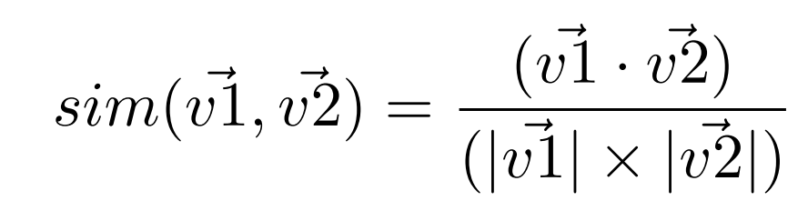
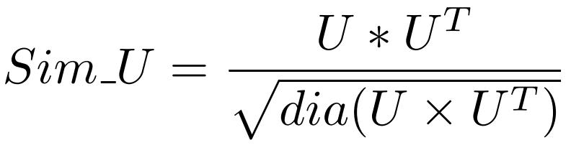
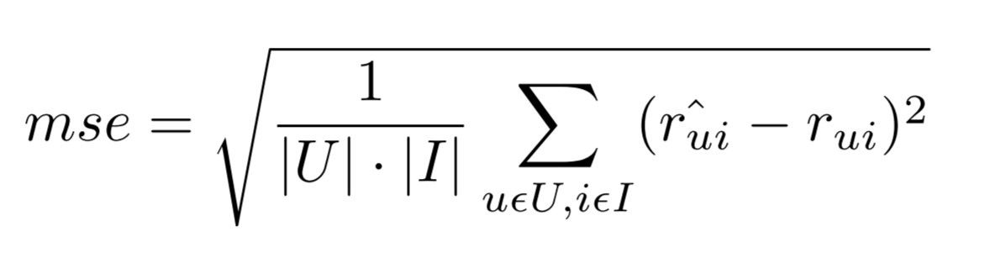
Recommendation System
Similarity: Cosine distance
Reduce computation complexity
Evaluation: MSE
Notes:
To represent the similarity between each pair of elements, we used the cosine distance. To make the computation more efficient, matrix operation is employed. For the evaluation part, we used the mse, which is mean squared error by subtracting the real rating star from the predicted rating.

Slide 13
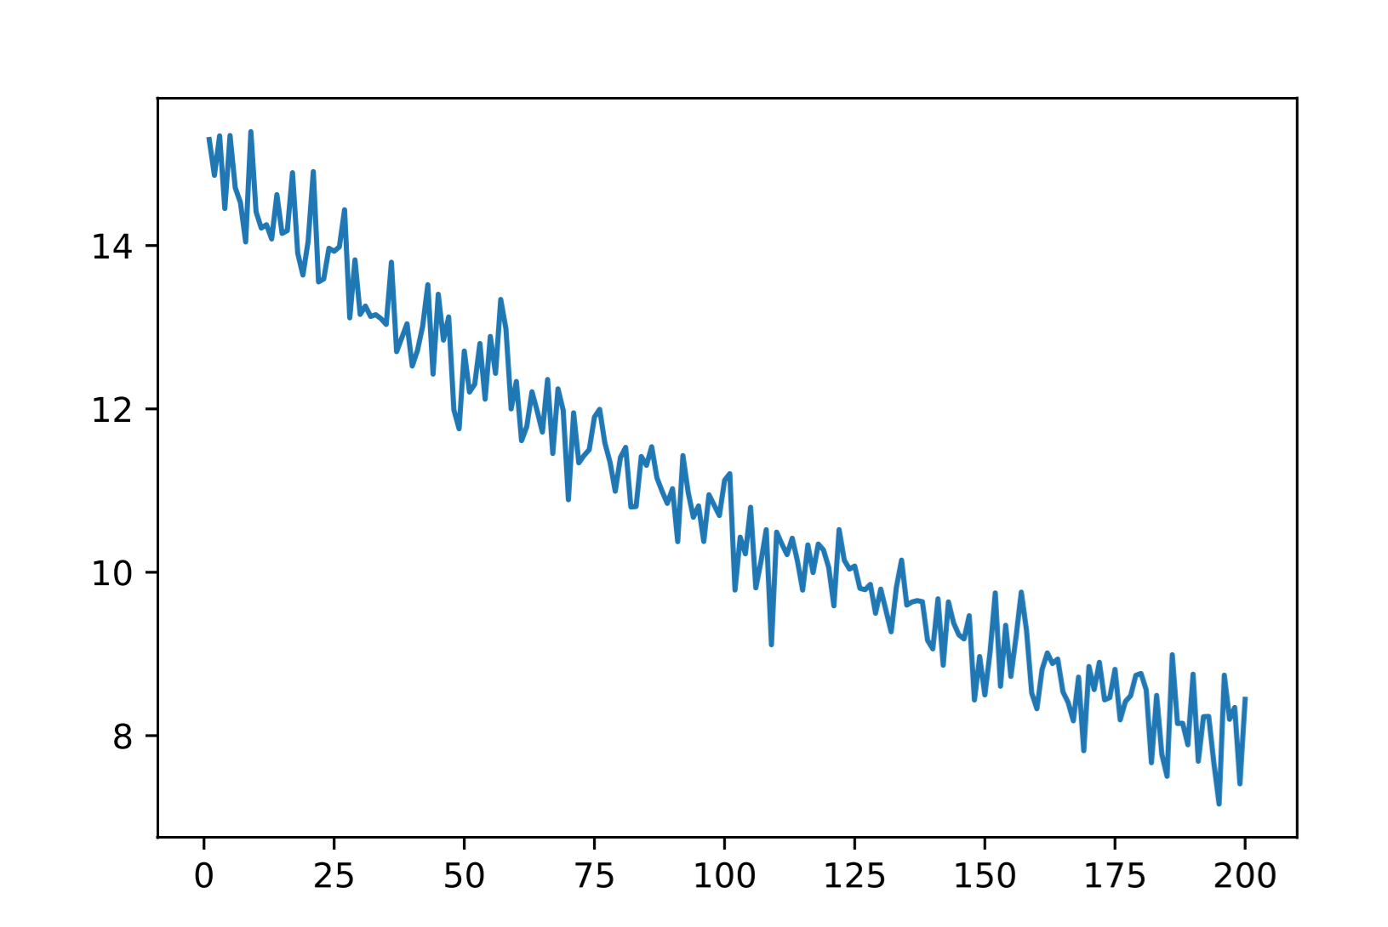
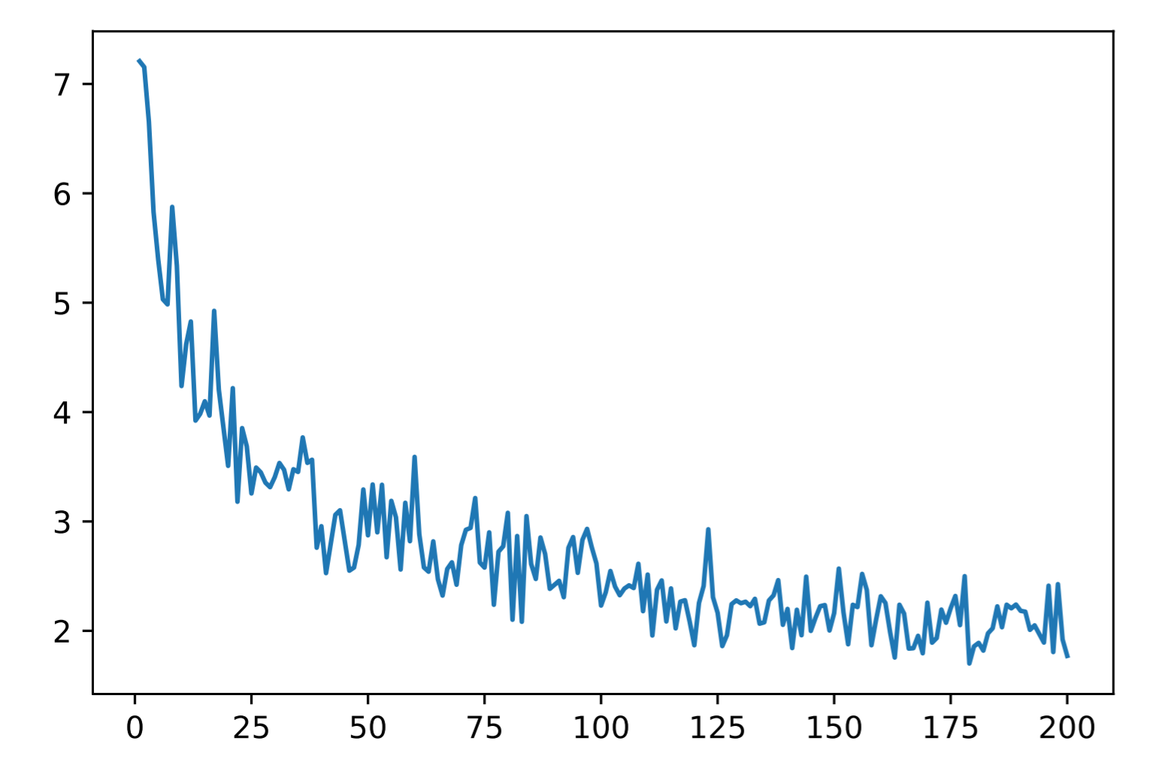
Recommendation System
Item-based
User-based
mse
mse
k
k
Notes:
Based on these principle, we built and evaluated the item-based and user based recommendation system using Here are the relationship between the mse and k for each recommendation system. We can easily found out that the user based one perform better. And considering the computation efficiency, 75 is a good k to be used for user based recommendation system.

Slide 14
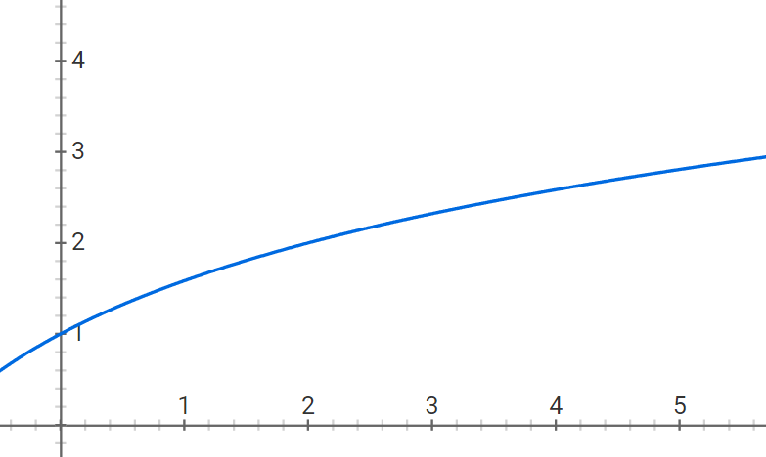
Recommendation System
Most of the review with count of useful being.
Range of useful count is from 0 to 247
Logistic function is used
Notes:
Besides these, we tries several methods to improve the performance of the recommendation system. One of that is to take the helpfulness into consideration, which is a logistic function of number of users who think the review is useful for them.

Slide 15
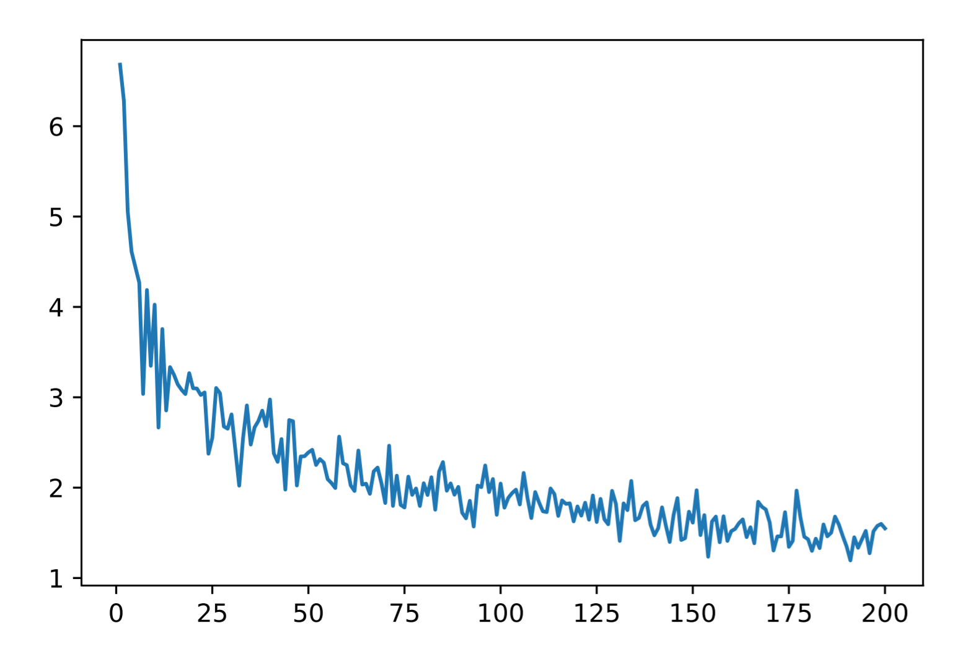
Recommendation System
User-based with helpfulness score
User-based
mse
mse
k
k
Notes:
After adding helpfulness score as weights to calculate the predicting value, the scored user-based recommendation seemed to perform better than the original one.

Slide 16
Recommendation System
Recommendation System demo
-based on the user based with helpfulness score
Input:
Index of user
Output:
Top five restaurants recommended
Meat & Potatoes Burgatory Maiku Sushi The Green Mango Chaya Japanese Cuisine
199
Notes:
we built a demo recommendation system based on the k nearest users with helpfulness score. Here is a show case. For the 199th users, we got these 5 restaurants to be recommended.

Slide 17
Topic Modeling
Sentiment Analysis to classify positive and negative reviews
- Used Google Cloud Natural Language API
Topic Modeling to discover latent hidden features in the reviews
- Used Latent Dirichlet Allocation (LDA)

Slide 18
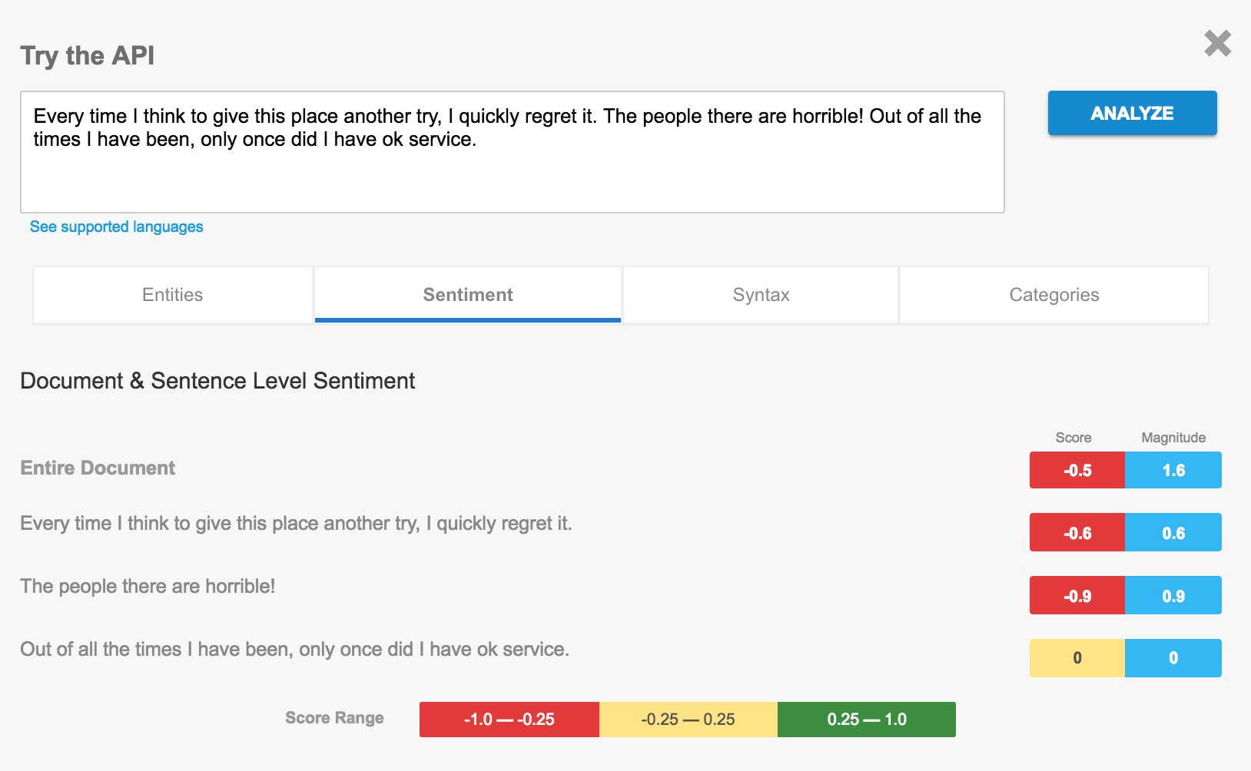
Sentiment Analysis Using Google Cloud Natural Language API

Slide 19
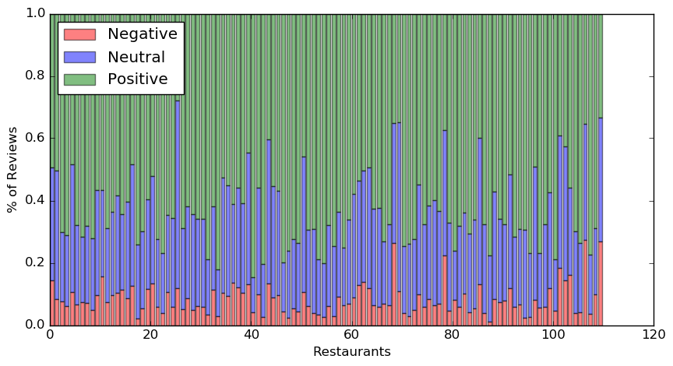
Sentiment distribution of Reviews in Pittsburgh (110 Restaurants, 38785 Reviews)

Slide 20
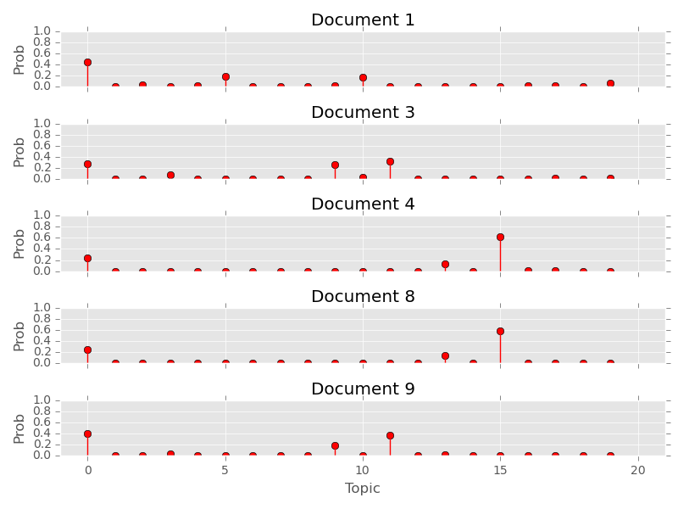
Topic Modeling using LDA
Document - Mixture of latent topics Topic - Probability distribution over words
Matrix Factorization Technique
Document-Term Matrix
=
Document-Topic Matrix
X
Topic-Word Matrix

Slide 21
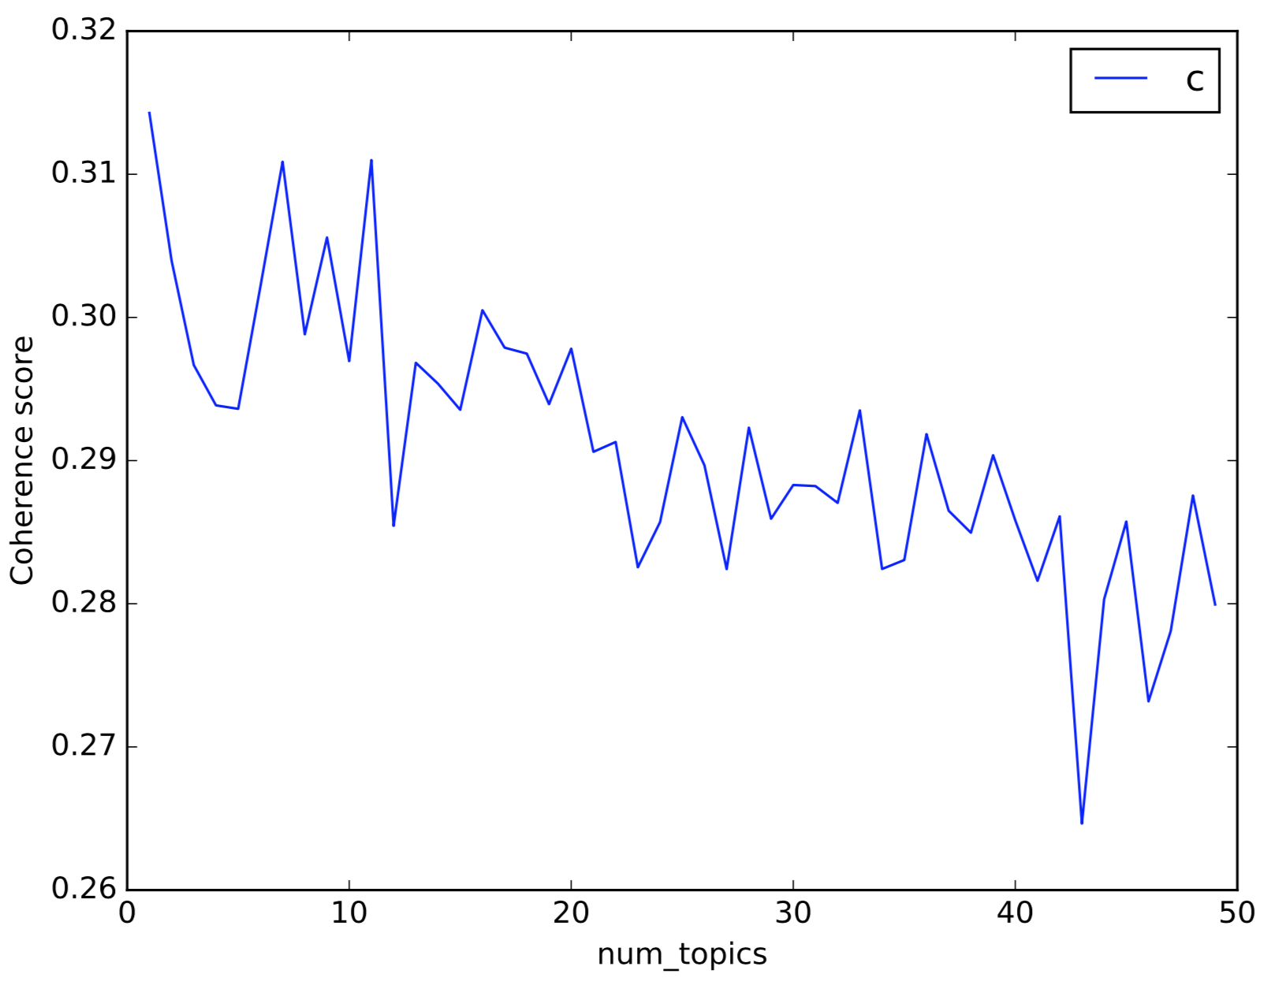
Topic Coherence - Choosing optimal number of topics
Score - Average of pairwise word-similarity of scores of words in topic.
Set num_topics = 12

Slide 22
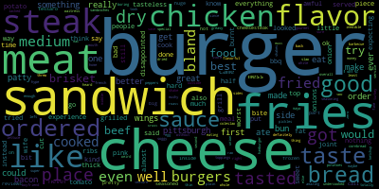
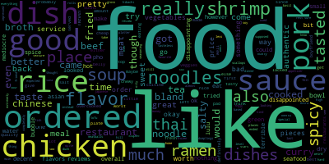
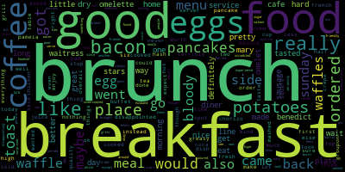
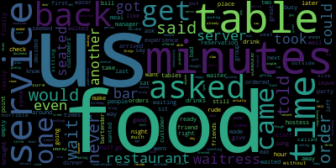
Visualization of topics using WordCloud, pyLDAvis
Food Items
Food Tastes
Meals
Service

Slide 23
For the full report, please visit:
https://github.com/emily-jean/yelp-data-mining/blob/master/reports/final/report.pdf

